Slide 1

“Bausparen”……as a Strategic Instrument
for Sustainable Housing Finance in Mongolia
European experience × Mongolian priorities | Dialogue presentation
Sabine König
designated CEO LBS NordOst AG
President of the European Federation
of Building Societies
Markus Loch
Country Director
German Sparkassenstifung Mongolia

Slide 2
“Bausparen”……as a Strategic Instrument
for Sustainable Housing Finance in Mongolia
European experience
Mongolian opportunity
stability • savings discipline
long-term housing finance
institutional trust
adapted,
not copied
affordability • local-currency funding
green housing • resilient households

Slide 3

Bausparen is not a German export product.........
It is a proven institutional logic: disciplined savings before responsible credit — adapted to Mongolian priorities.
adapted, not copied
Perception
Reality
“Home savings is uniquely German — therefore unsuitable for Mongolia.”
Contractual savings for housing have been applied in different institutional forms across several markets.
German Sparkassenstiftung MONGOLIA
This objection focuses on the country of origin, not on the financial mechanism: disciplined savings followed by
responsible credit.
The value proposition is institutional discipline: purpose-bound saving, transparent rules, supervision and
consumer protection.
Key question for Mongolia: Which safeguards make households mortgage-ready without creating hidden fiscal or banking-sector risks?
5

Slide 4
………but a global phenomenon!?!?!?
Europe:
Germany
Austria
France
Belgium
Luxembourg
Czech Republic
Slovakia
Hungary
Slovenia
Croatia
Romania
Serbia
Bosnia and Herzegovina
Latin America:
Mexico
Brazil
MENA / North Africa:
Morocco
Tunisia
Turkey
Africa:
South Africa
Asia / Eurasia:
China
Japan
South Korea
Singapore
Malaysia
Vietnam???
Indonesia
India
Kazakhstan

Slide 5
International experience: recurring design principles
The value for Mongolia lies in selecting proven safeguards: regulation, transparency, liquidity management
and fiscal discipline.
1
Mature regulated
models
2
Transition-market
adaptations
3
Adjacent housing-
savings approaches
Germany · Austria
Czech Republic · Slovakia
Hungary · Romania
Croatia · Kazakhstan
China · Singapore
Malaysia and others
German Sparkassenstiftung MONGOLIA
• Specialised institutions
• Tariff logic and ALM
• Strong supervision + trust
• State bonus design
• Market-introduction lessons
• Clear fiscal limits
• Savings discipline
• Earmarked housing finance
• Institutional mobilisation
Mongolian design task:
build a BAUSPAR SYSTEM with clear licensing,
capped incentives, consumer protection, liquidity rules
and a complementary role for banks and MIK
6

Slide 6
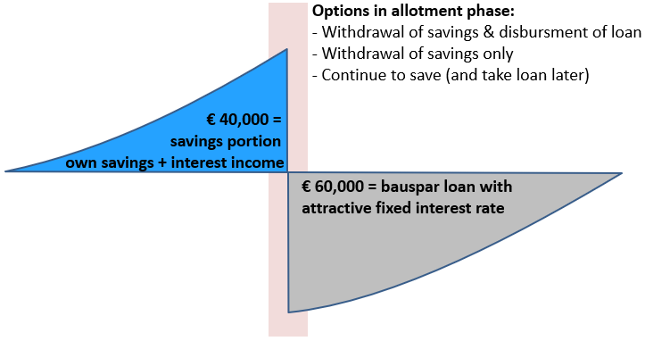
“Bausparen” is a specific financial instrument designed to help people help themselves, independent of the capital markets
Interest rates for deposit and loan are fixed when the contract is concluded.
Contract sum 100,000 €
Savings 40,000 €
Fixed interest loan 60,000 €
Closing fee covers administrative + distribution costs
Savings phase
Allotment phase
Loan/Repayment phase
year 1 ……………………………………… year 7 …………………………………………. year 18

Slide 7

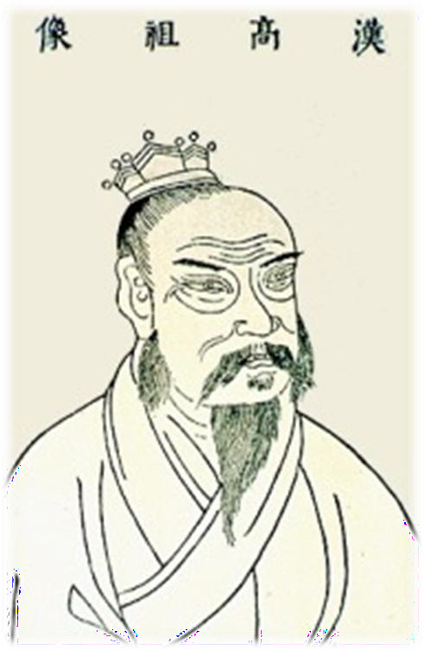



“Bausparen” is really old, but more than experienced”
10 years
10 Units
„each 1 Unit“
1st ➔ 1st year
2nd ➔ 2nd year
………………….
……………….....
………………….
10th ➔ 10th year
10 Units
“Liu Bang”
Founder of the Han Dynasty
7

Slide 8
Three housing-finance hurdles — Germany × Mongolia
Bausparen is a sequenced mechanism: save first, qualify, finance responsibly and modernize over time.
GERMAN THESIS | mature-market lesson
MONGOLIAN THESIS | reform priority
Germany: the proof of mechanism
1 Equity barrier
Even in a mature mortgage market, rent-paying capacity is not the same as mortgage readiness: equity and transaction costs remain the gatekeeper
2 Rate-reset risk
Households at the affordability threshold are vulnerable when fixed-rate periods expire and refinancing rates rise
3 Green modernization pressure
Volatile fossil-energy costs and efficiency standards turn renovation into a financial-stability and value-preservation issue
Mongolia: the policy transfer
1 First 30% equity gap
The first 30% blocks many households before the mortgage; without a savings path, subsidy programmes cannot reach sufficient scale
2 Access and rate uncertainty
Waiting lists and high market rates delay life decisions. Clear local-currency rules can convert demand into bankable demand
3 Life-cycle and green demand
Families need finance for moving, renovation, insulation and heating — not only for the first purchase
Same mechanism, different starting point:
Germany demonstrates the stabilising logic;
Mongolia can adapt it to affordability, local-currency funding and green housing

Slide 9
Bauspar Thesis 1: Equity is the real entry barrier
Germany and Mongolia show the same rule: households must become mortgage-ready before they borrow.
GERMAN THESIS | mature-market lesson
MONGOLIAN THESIS | reform priority
German thesis
“Rent capacity does not equal purchase capacity.”
Many tenant households can carry a mortgage-like monthly burden from current rent, but fail at the equity and transaction-cost threshold
Indicative message for Germany: around 39% of tenants could pay the loan instalment, but lack sufficient equity
Bausparen builds a visible savings record, early advice and a credible equity bridge before the mortgage
Implication: Bausparen is a pre-mortgage qualification mechanism
Mongolian thesis
“The first 30% is too far away.”
Missing equity layer to become
mortgage-ready:
Group 2: ~55m MNT
Group 3: ~86m MNT
Group 4: ~132m MNT
250k MNT/month over 6 years can build ~22–25m MNT with bonus/interest
A Bauspar loan can leverage savings as an equity bridge and create a bankable mortgage customer
Implication: the BAUSPAR SYSTEM creates the missing equity layer
Source: German market experience / Savings Study 2026; Feasibility Study V7, Box 7.2.2 and Table 7.5.
Political message: a BauSparBank does not replace the mortgage —
it creates the missing equity layer
that makes the mortgage socially and financially reachable

Slide 10
Bauspar Thesis 2: Interest-rate volatility creates insecurity
Predictability is a social-policy instrument when rates and refinancing conditions are unstable.
GERMAN THESIS | mature-market lesson
MONGOLIAN THESIS | reform priority
German thesis
“Affordability must survive the next interest-rate cycle.”
German housing finance usually relies on fixed-rate periods — not permanent lifetime certainty
Threshold households can be hit hard when the fixed-rate period expires and refinancing rates are higher
Bausparen fixes the future Bauspar loan rate at contract signing and reduces refinancing anxiety for planned housing steps
Public support is targeted, capped and linked to own savings — not an open-ended interest subsidy
Implication: Bausparen functions as disciplined interest-rate insurance
Mongolian thesis
“Predictability can unlock responsible demand.”
Subsidized mortgage: 6% p.a., approx. 2-year waiting list, BoM finances ~80% of new loans, funding gap around 4tn MNT
Market mortgage: 16–24% p.a.; often unaffordable; monthly payments often 2–3x AHFP
BAUSPAR SYSTEM offers local-currency savings and loan logic, clear allocation scoring, ALM limits and stress testing
The promise is not “cheap money forever”, but a regulated path from saving to financing
Implication: predictability reduces decision paralysis and fiscal pressure
Source: Feasibility Study V7, Executive Summary and 3.3–3.5; Market Study on Mongolia housing finance ecosystem.
Political message: in a volatile rate environment, predictability
becomes social policy — and financial stability

Slide 11
Bauspar Thesis 3: Housing needs follow life phases
Home finance does not end with the first purchase; renovation and green modernization become the next affordability frontier.
GERMAN THESIS | mature-market lesson
MONGOLIAN THESIS | reform priority
German thesis
“Modernization is part of housing affordability.”
German experience: Bausparen is usually one module combined with bank loans and public promotion
For smaller renovation in debt-free homes, Bauspar loans are often used as stand-alone finance
Fossil-energy costs are volatile; energy efficiency affects running costs, property value and long-term affordability
Typical use cases: insulation, heating, windows, roofs, accessibility and modernization
Implication: Bausparen finances the full housing life cycle
Mongolian thesis
“The housing journey continues after the first purchase.”
Demand already visible:
56% plan to move within 5 years
16% want to renovate their current home
76% name housing prices as the main barrier
46% name lack of credit as a key barrier
a BAUSPAR SYSTEM can support first purchase,
family growth, renovation, insulation and heating
a Green BAUSPAR SYSTEM creates a bankable pipeline for banks and IFIs while improving health and dignity
Implication: green housing becomes affordable step by step
Source: Savings Study 2026, housing aspirations and barriers; Feasibility Study V7, Chapters 7 and 10; Market Study on green/renovation relevance.
Political message: a home is not only an asset — it is family stability, health, education opportunity and confidence in the future

Slide 12
Why this matters — Bausparen strengthens the whole ecosystem
The systemic argument: de-risk demand before it enters the mortgage market — without weakening existing institutions.
GERMAN EXPERIENCE | system lesson
MONGOLIAN RELEVANCE | ecosystem value
German thesis
“Bausparen is a complementary stability module — not a replacement for banks.”
Typically combined with bank loans and public development or promotion schemes
For smaller modernization of debt-free homes,
a Bauspar contract can often finance the investment alone
The value is institutional: savings discipline, transparent allocation, fixed product rules and supervision
Trust is created by prudential limits and a collective that is largely independent of capital-market refinancing
Implication: the model works best as part of a regulated housing-finance architecture
Mongolian thesis
“The win is a stronger mortgage ecosystem — for public policy, MIK, banks and investors.”
Government
Socially credible access; capped incentives instead of open-ended subsidy pressure.
Social stability + green-housing pathway
MIK / Ecosystem
Prepared borrowers and purpose-bound housing demand before mortgage entry.
Pipeline quality + less pressure on subsidies
Banks / Investors
Lower information asymmetry, stronger customer discipline and bankable green projects.
Risk-adjusted scale + MNT savings base
Principle: complement the ecosystem —
do not compete with banks or create hidden fiscal risks.
Political message: Mongolia needs a sequenced institutional pathway that
prepares households, improves portfolio quality and supports green modernization

Slide 13

“Remove the hurdles before the mortgage.”

Slide 14
“Remove the hurdles before the mortgage.”
Bausparen is an institutional stability mechanism: it links household resilience, local-currency funding, responsible lending and green housing.
For Mongolia, this is not about importing a German product.
It is about building a
Mongolian pathway to
housing dignity, financial stability and green modernization.
Thank you!!!

